Slide 1
Tables, Records, and Fields
Introduction to tables, records, and fields
Databases are made up of a series of interconnected and related tables. Those tables contain fields to help you categorize the data that your tables store. And of course, ultimately, you'll end up with hundreds, potentially thousands of records in your database.
In this lecture, we'll cover these concepts with a little more detail. Specifically we'll look at:
Tables
Records
Fields / Columns

Slide 2
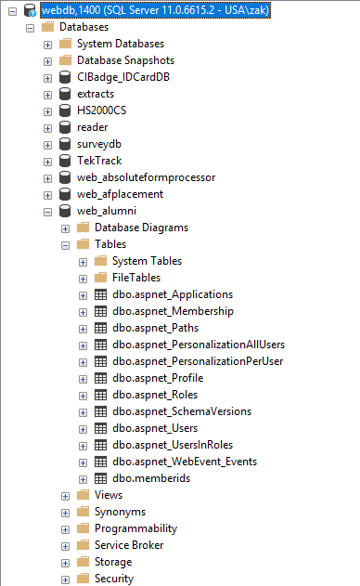
Tables, Records, and Fields
Tables
A database table is composed of records and fields / columns that hold data. Each table in a database holds data about a different, but related, subject.
The example shown here is a selected cutaway from SQL Server Management Studio that outlines numerous databases. The selected database is for a college's Alumni database.
You can see the database has numerous tables that undoubtedly include information about alumni membership on the website, role, custom profile information, unique membership id, and more.

Slide 3
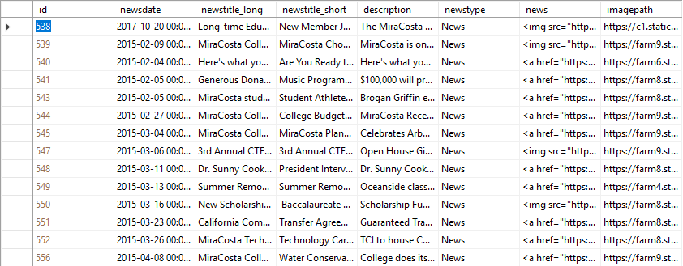
Tables, Records, and Fields
Records
Data is stored in records. A record is composed of fields / columns and contains all the data about one particular person, company, or item in a database. In this database, a record contains the data for one news item for a college's public-facing website. Records will appear as rows in the database table. Here, a record for id 543 is highlighted in red.
Fields
Record

Slide 4
Tables, Records, and Fields
Fields
A field is part of a record and contains a single piece of data for the subject of the record. In the database table outlined in the previous slide, each record contains eight fields:
id A number assigned to each news item in the table
newsdate The date that the news items was published
newstitlelong The news title that appears on the web page
newstitleshort The news title that appears on call to action images
description The actual news story
newstype Whether the news item was a news article or press release
news The image that appears as a call to action on the home page
imagepath The image that appears on the actual news article
Fields appear as columns in a database table. These are also highlighted in the previous slide.

Slide 5
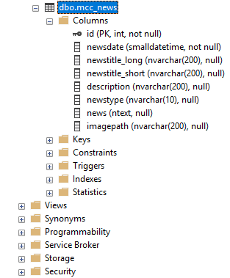
Tables, Records, and Fields
Columns
In some databases, fields are referred to as columns. In SQL Server for instance, Management Studio lists all of the columns belonging to a table by simply expanding the table and then expanding the columns.
Management Studio will also show you critical information about your columns including key information, data types associated with your columns, size, and more.

